Slide 1
Design Engineering
CO4: Student will be able to design & develop the software solutions for the growth of society

Slide 2
Contents
Design Process & quality
Design Concepts
The design Model
Pattern-based Software Design

Slide 3
Purpose of Design
Design is where customer requirements, business needs, and technical considerations all come together in the formulation of a product or system
The design model provides detail about the software data structures, architecture, interfaces, and components.
The design model can be assessed for quality and be improved before code is generated and tests are conducted
  Does the design contain errors, inconsistencies, or omissions?
  Are there better design alternatives?
  Can the design be implemented within the constraints, schedule, and cost that have been established?

Slide 4
Purpose of Design (continued)
A designer must practice diversification and convergence
  The designer selects from design components, component solutions, and knowledge available through catalogs, textbooks, and experience
  The designer then chooses the elements from this collection that meet the requirements defined by requirements engineering and analysis modeling
  Convergence occurs as alternatives are considered and rejected until one particular configuration of components is chosen
Software design is an iterative process through which requirements are translated into a blueprint for constructing the software
  Design begins at a high level of abstraction that can be directly traced back to the data, functional, and behavioral requirements
  As design iteration occurs, subsequent refinement leads to design representations at much lower levels of abstraction

Slide 5
From Analysis Model to Design Model
Each element of the analysis model provides information that is necessary to create the four design models
  The data/class design transforms analysis classes into design classes along with the data structures required to implement the software
  The architectural design defines the relationship between major structural elements of the software; architectural styles and design patterns help achieve the requirements defined for the system
  The interface design describes how the software communicates with systems that interoperate with it and with humans that use it
  The component-level design transforms structural elements of the software architecture into a procedural description of software components

Slide 6
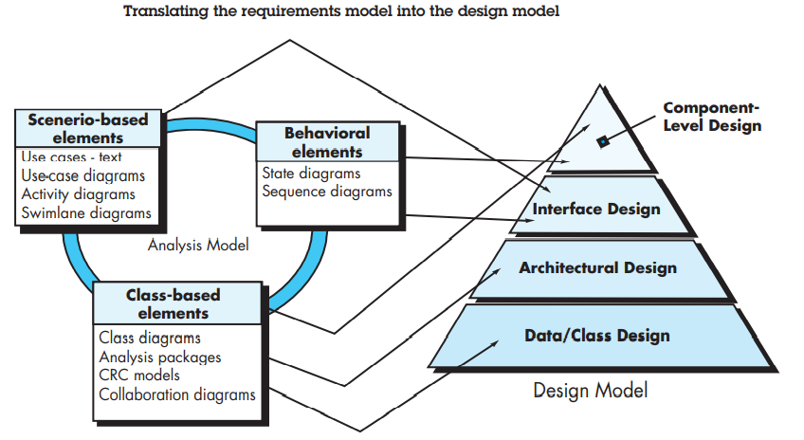

Slide 7
From Analysis Model to Design Model (continued)
Component-level Design
(Class-based model, Flow-oriented model
Behavioral model)
Interface Design
(Scenario-based model, Flow-oriented model
Behavioral model)
Architectural Design
(Class-based model, Flow-oriented model)
Data/Class Design
(Class-based model, Behavioral model)

Slide 8
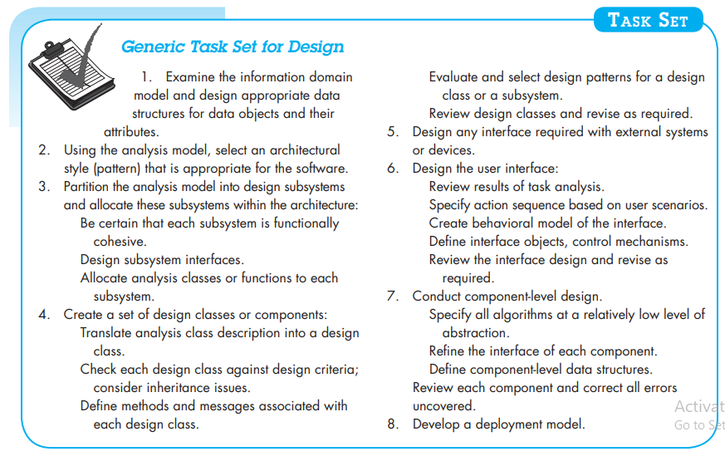

Slide 9
Task Set for Software Design
Examine the information domain model and design appropriate data structures for data objects and their attributes
Using the analysis model, select an architectural style (and design patterns) that are appropriate for the software
Partition the analysis model into design subsystems and allocate these subsystems within the architecture
  Design the subsystem interfaces
  Allocate analysis classes or functions to each subsystem
Create a set of design classes or components
  Translate each analysis class description into a design class
  Check each design class against design criteria; consider inheritance issues
  Define methods associated with each design class
  Evaluate and select design patterns for a design class or subsystem

Slide 10
Task Set for Software Design (continued)
Design any interface required with external systems or devices
Design the user interface
Conduct component-level design
  Specify all algorithms at a relatively low level of abstraction
  Refine the interface of each component
  Define component-level data structures
  Review each component and correct all errors uncovered
Develop a deployment model
  Show a physical layout of the system, revealing which components will be located where in the physical computing environment

Slide 11
Case Study:
Hospital Management System-UML diagrams

Slide 12
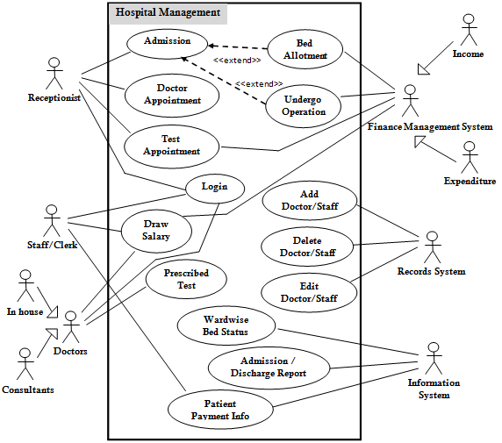

Slide 13
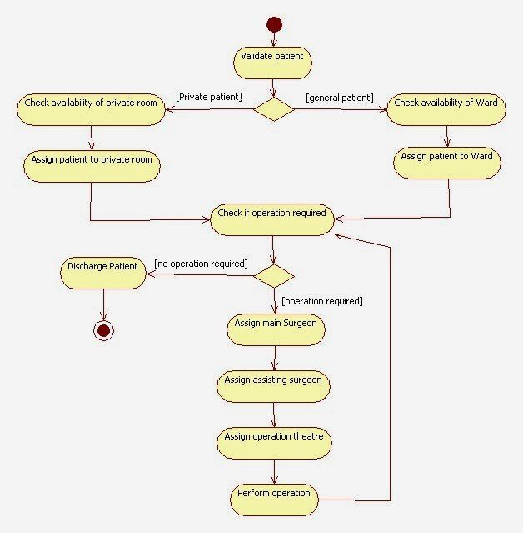
Activity Diagram

Slide 14
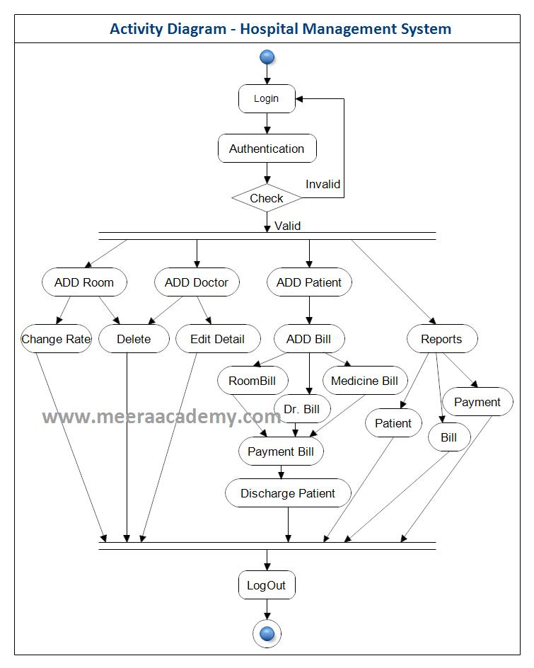

Slide 15
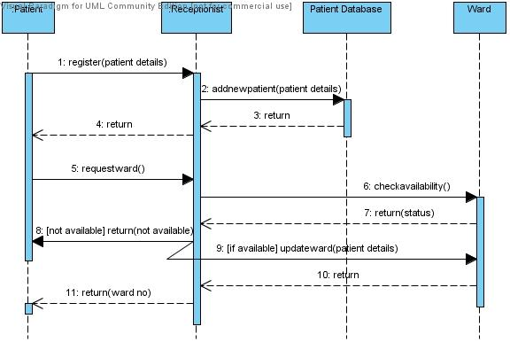
Sequence Diagram

Slide 16
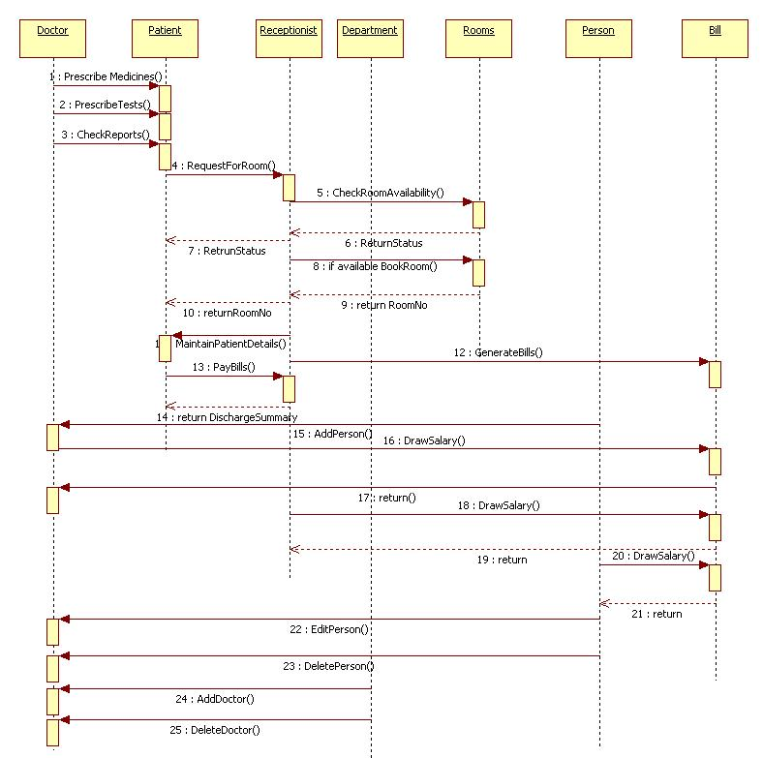

Slide 17
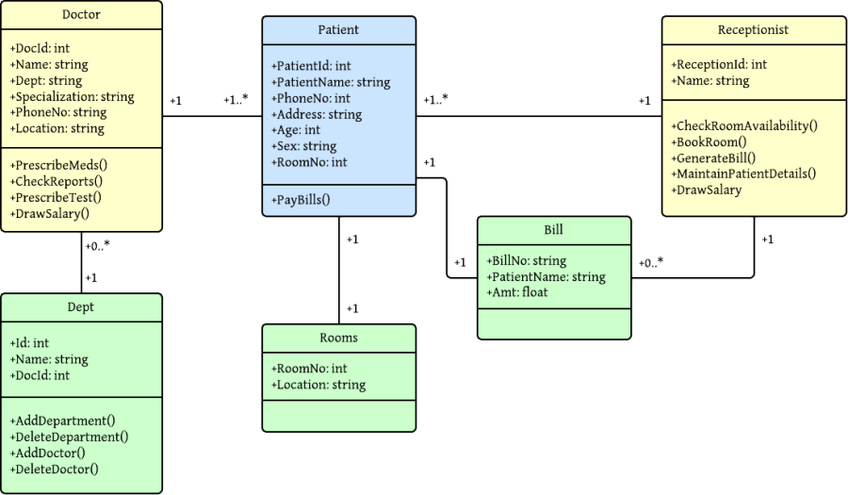
Class Diagram

Slide 18
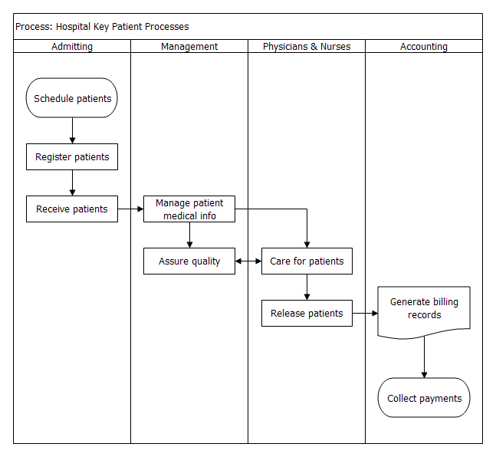
Swimlane diagram

Slide 19
Design Quality

Slide 20
Design Quality's Role
The importance of design is quality
Design is the place where quality is fostered
  Provides representations of software that can be assessed for quality
  Accurately translates a customer's requirements into a finished software product or system
  Serves as the foundation for all software engineering activities that follow
Without design, we risk building an unstable system that
  Will fail when small changes are made
  May be difficult to test
  Cannot be assessed for quality later in the software process when time is short and most of the budget has been spent
The quality of the design is assessed through a series of formal technical reviews or design walkthroughs

Slide 21
Goals of a Good Design
The design must implement all of the explicit requirements contained in the analysis model
  It must also accommodate all of the implicit requirements desired by the customer
The design must be a readable and understandable guide for those who generate code, and for those who test and support the software
The design should provide a complete picture of the software, addressing the data, functional, and behavioral domains from an implementation perspective
"Writing a clever piece of code that works is one thing; designing something
that can support a long-lasting business is quite another."

Slide 22
Design Quality Guidelines
A design should exhibit an architecture that
  Has been created using recognizable architectural styles or patterns
  Is composed of components that exhibit good design characteristics
  Can be implemented in an evolutionary fashion, thereby facilitating implementation and testing
A design should be modular; that is, the software should be logically partitioned into elements or subsystems
A design should contain distinct representations of data, architecture, interfaces, and components
A design should lead to data structures that are appropriate for the classes to be implemented and are drawn from recognizable data patterns

Slide 23
Quality Guidelines (continued)
A design should lead to components that exhibit independent functional characteristics
A design should lead to interfaces that reduce the complexity of connections between components and with the external environment
A design should be derived using a repeatable method that is driven by information obtained during software requirements analysis
A design should be represented using a notation that effectively communicates its meaning
"Quality isn't something you lay on top of subjects and objects
like tinsel on a Christmas tree."

Slide 24
Design Concepts
Abstraction
  Procedural abstraction – a sequence of instructions that have a specific and limited function
  Data abstraction – a named collection of data that describes a data object
Architecture
  The overall structure of the software and the ways in which the structure provides conceptual integrity for a system
  Consists of components, connectors, and the relationship between them
Patterns
  A design structure that solves a particular design problem within a specific context
  It provides a description that enables a designer to determine whether the pattern is applicable, whether the pattern can be reused, and whether the pattern can serve as a guide for developing similar patterns

Slide 25
Design Concepts (continued)
Modularity
  Separately named and addressable components (i.e., modules) that are integrated to satisfy requirements (divide and conquer principle)
  Makes software intellectually manageable so as to grasp the control paths, span of reference, number of variables, and overall complexity
Information hiding
  The designing of modules so that the algorithms and local data contained within them are inaccessible to other modules
  This enforces access constraints to both procedural (i.e., implementation) detail and local data structures
Functional independence
  Modules that have a "single-minded" function and an aversion to excessive interaction with other modules
  High cohesion – a module performs only a single task
  Low coupling – a module has the lowest amount of connection needed with other modules
(more on next slide)

Slide 26
Design Concepts (continued)
Stepwise refinement
  Development of a program by successively refining levels of procedure detail
  Complements abstraction, which enables a designer to specify procedure and data and yet suppress low-level details
Refactoring
  A reorganization technique that simplifies the design (or internal code structure) of a component without changing its function or external behavior
  Removes redundancy, unused design elements, inefficient or unnecessary algorithms, poorly constructed or inappropriate data structures, or any other design failures
Design classes
  Refines the analysis classes by providing design detail that will enable the classes to be implemented
  Creates a new set of design classes that implement a software infrastructure to support the business solution

Slide 27
Types of Design Classes
User interface classes – define all abstractions necessary for human-computer interaction
Business domain classes – refined from analysis classes; identify attributes and services (methods) that are required to implement some element of the business domain
Process classes – implement business abstractions required to fully manage the business domain classes
Persistent classes – represent data stores (e.g., a database) that will persist beyond the execution of the software
System classes – implement software management and control functions that enable the system to operate and communicate within its computing environment and the outside world

Slide 28
Characteristics of a Well-Formed Design Class
Complete and sufficient
  Contains the complete encapsulation of all attributes and methods that exist for the class
  Contains only those methods that are sufficient to achieve the intent of the class
Primitiveness
  Each method of a class focuses on accomplishing one service for the class
High cohesion
  The class has a small, focused set of responsibilities and single-mindedly applies attributes and methods to implement those responsibilities
Low coupling
  Collaboration of the class with other classes is kept to an acceptable minimum
  Each class should have limited knowledge of other classes in other subsystems

Slide 29
The Design Model
Component-level Design
Interface Design
Architectural Design
Data/Class Design

Slide 30
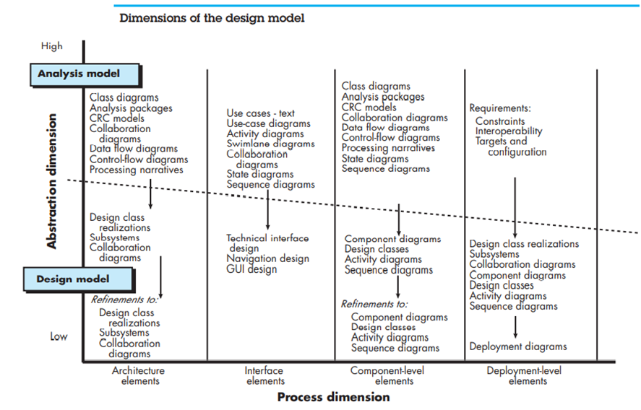

Slide 31
Introduction
The design model can be viewed in two different dimensions
  (Horizontally) The process dimension indicates the evolution of the parts of the design model as each design task is executed
  (Vertically) The abstraction dimension represents the level of detail as each element of the analysis model is transformed into the design model and then iteratively refined
Elements of the design model use many of the same UML diagrams used in the analysis model
  The diagrams are refined and elaborated as part of the design
  More implementation-specific detail is provided
  Emphasis is placed on
    Architectural structure and style
    Interfaces between components and the outside world
    Components that reside within the architecture
(More on next slide)

Slide 32
Introduction (continued)
Design model elements are not always developed in a sequential fashion
  Preliminary architectural design sets the stage
  It is followed by interface design and component-level design, which often occur in parallel
The design model has the following layered elements
  Data/class design
  Architectural design
  Interface design
  Component-level design
A fifth element that follows all of
the others is deployment-level design
Component-level Design
Interface Design
Architectural Design
Data/Class Design

Slide 33
Design Elements
Data/class design
  Creates a model of data and objects that is represented at a high level of abstraction
Architectural design
  Depicts the overall layout of the software
Interface design
  Tells how information flows into and out of the system and how it is communicated among the components defined as part of the architecture
  Includes the user interface, external interfaces, and internal interfaces
Component-level design elements
  Describes the internal detail of each software component by way of data structure definitions, algorithms, and interface specifications
Deployment-level design elements
  Indicates how software functionality and subsystems will be allocated within the physical computing environment that will support the software

